Slide 1
Efficiency of Algorithms
Recursion
(Chapters 4,7)
Dr. Maher Mneimneh

Slide 2
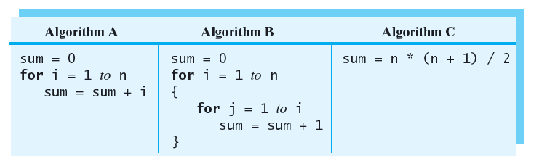
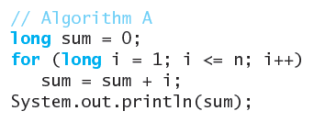
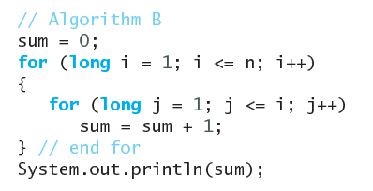

Measuring the Efficiency of Algorithms
Motivation: Write a function that takes n as argument and returns the result of sum of 1 + 2 + 3 + 4 + … + n

Slide 3
Analysis of Algorithms
An algorithm has both time and space requirements called its complexity
Time complexity: the time it takes to execute
Space complexity: the space it needs to execute
Analysis of algorithms
Process of measuring the complexity of algorithms
We will concentrate on time complexity and sometimes show memory complexity
Complexity is expressed in terms of size of the problem
Example: for searching an array, the number of items in the array is the problem size
We find a function of the problem size that behaves like the algorithms runtime or space requirements
Such a function is called a growth-rate function: measures how runtime grows with problem size

Slide 4
Counting Basic Operations
Count the number of basic operations per line
 | Operations
 | 1
 | 3n + 2
 | 2n
1 assignment
n + 1 comparisons
n additions
n assignments
Operations of Algorithm A: 1 + 3n + 2 + 2n = 5n + 3
 | Operations
 | 3
Operations of Algorithm C: 3

Slide 5
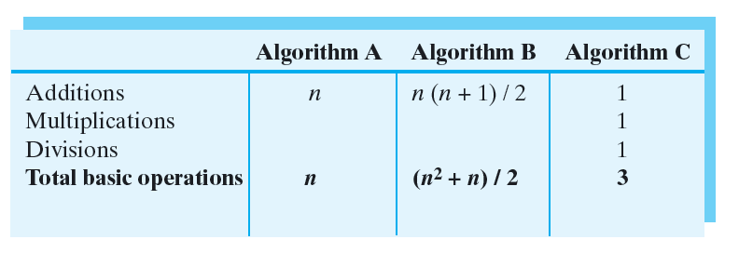
Counting Basic Operations
Sometimes we don’t care about exact count of operations
For algorithm A, it might be sufficient that time grows linearly with n
Count basic operations instead: most significant contributor to runtime
addition/multiplication/division

Slide 6
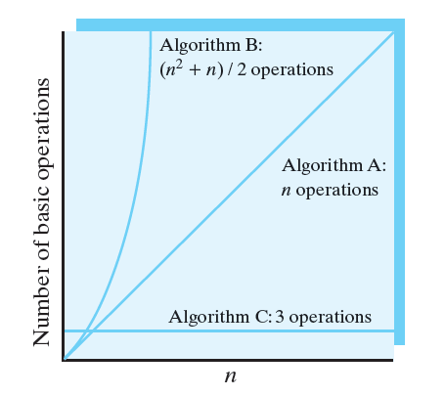
Counting Basic Operations
Plotting number of basic operations vs n

Slide 7
Algorithm Growth Rates
We care about the behavior of the algorithm for large values of n
(n² +n)/2 behaves like n²
n² is much larger than n so (n² +n)/2 behaves like n² /2
n² /2 behaves like n²
In other words, the difference between (n² +n)/2 and n² is relatively small and can be ignored
We can say that
algorithm A requires time proportional to n
algorithm B requires time proportional to n²
algorithm C requires time that is independent of n

Slide 8
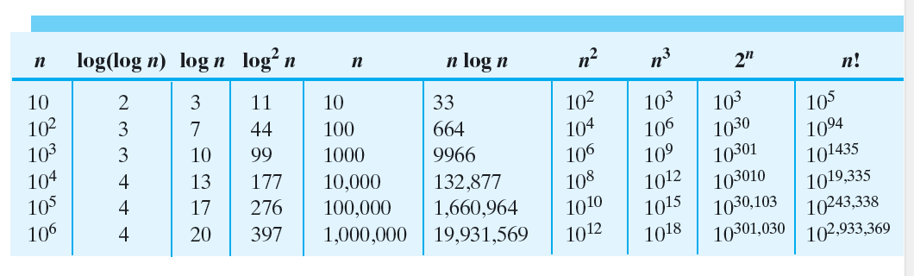
Algorithm Growth Rates
Relative magnitude of common growth-rate functions
1 < log(logn) < logn < log²n < n < nlogn < n² < n³ < 2^{n} < n!

Slide 9
Best, Worst and Average Cases
For some algorithms execution time depends only on the input size
Example: finding the minimum value in an array
Execution time can depend on the data itself (in addition to the input size)
Example: searching for a value in an array of size n
One comparison is required if desired value is in first location – best case
n comparisons are required if desired value is in last location – worst case

Slide 10
Big Oh Notation
Instead of saying algorithm A has a time requirement proportional to n, we can say A is O(n)
B is O(n²)
C is O(1)
Goal of big Oh is to replace a complex function with a simpler function that has the same order of growth
f(n) is O(g(n)) means that
There exists a constant c such that c.g(n) provides an upper bound on f(n) when n is sufficiently large
c.g(n)
f(n)
n

Slide 11
Big Oh Notation
Motivation for Big O
We would like to consider functions which have a constant ratio to be of the same complexity
E.g:
n, 2n, 3n are of the same complexity
n², 2n², 2000n² are of the same complexity
Motivation:
We only want to relate the time complexity to input size rather than how addition or assignment or multiplication is implemented by the computer
We will pick specific functions: n, nlogn, n², …
If algorithm requires time proportional to n (e.g, 2n, 10000n, …) then we say that the algorithm is O(n)
If algorithm requires time proportional to n² (e.g, n², 2n², 2000n²) then we say that the algorithm is O(n²)

Slide 12
Order-of-Magnitude Analysis and Big O Notation
Deeper look at big O notation
Are we really saying that given these 2 algorithms
Algo 1 requires 2n operations
Aglo 2 requires 10000n operations
it doesn’t matter which one we implement?
NO: Practically it matters, but we are saying that if we have a huge number n, those two algorithms have “similar power” and are much better than an algorithm that requires n² operations

Slide 13
Order-of-Magnitude Analysis and Big O Notation
Order of growth of some common functions
O(1) < O(log₂n) < O(n) < O(n * log₂n) < O(n²) < O(n³) < O(2^{n})
Properties of growth-rate functions
You can ignore low-order terms
O(n² + n) = O(n²)
O(n³ + logn) = O(n³)
O(n³ + 4n² + 3n) = O(n³)
You can ignore a multiplicative constant in the high-order term
O(5n³) = O(n³)
O(f(n)) + O(g(n)) = O(f(n) + g(n))
O(n²) + O(n) = O(n²+n) = O(n²)
O(m) + O(n) = O(m+n)

Slide 14
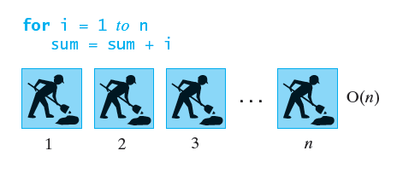
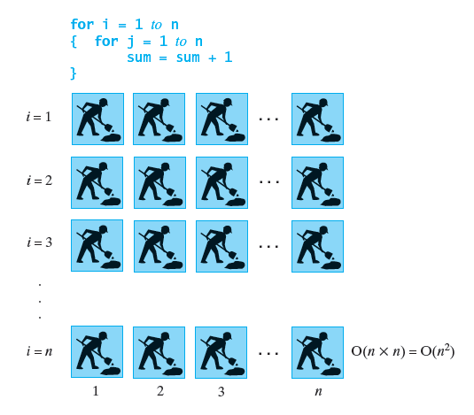
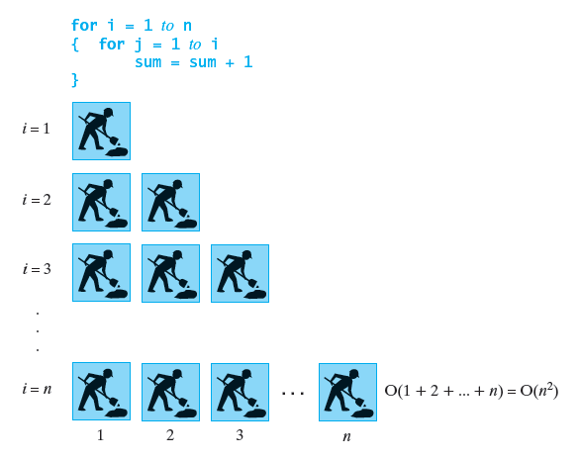
Visualizing Complexity

Slide 15
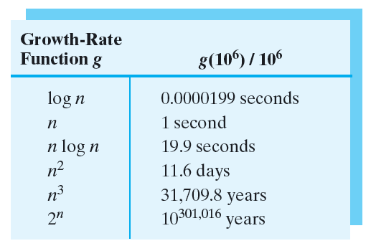
Visualizing Complexity
Assume that computer can perform 1 million operations per second. How long will it take to solve problem of size 1 million ?
How does these numbers compare the age of universe?
Approximate age of universe 13.75 Billion years ~ 4.4 * 10¹⁷ sec ~ 4.4x10²⁰ msec

Slide 16
Recursion
Repetition is a major feature of many algorithms
Two approaches to repetition
Iteration
Straightforward and efficient way to implement a repetitive process
Recursion:
For some problems, finding an iterative solution is not an easy task
Recursion provides an alternative for such problems
Recursive solutions fall in 3 main categories
Best choice for solving a problem
Provide insight for a better iterative solution
Should not be used at all because they are inefficient

Slide 17
What is Recursion?
Solve a problem by breaking it into small identical problems
Eventually you will reach a smaller problem whose solution is either obvious or given
Example : counting down from a positive integer
Iterative solution
public static void countDown (int n) {
for(int i = n; i >0; --i)
System.out.println(i);
}
Iterative solution 2
public static void countDown (int n) {
while(n >= 1) {
System.out.println(n);
n--;
}
}
Recursive solution
public static void countDown (int n) {
System.out.println(n);
if(n > 1)
countDown(n – 1);
}

Slide 18
What is Recursion?
Steps to recursive solution in countDown
countDown displays the given integer as part of the solution
The method solves the smaller problem of counting down from n-1 by calling itself recursively
countDown checks if it has reached a base case. The base case here occurs when integer is 1. After printing 1, nothing remains to be done
Design guidelines for successful recursion
method must be given an input value: either as an argument or by reading a value
method contains code to handle different cases of the input value (the code usually has if statements)
One or more of the cases should provide a solution that doesn’t require recursion (base cases)
One or more cases must include a recursive invocation of the method. The recursive method should take a step towards the base case by using “smaller” arguments or solving “smaller” versions of the task

Slide 19
What is Recursion?
Example : Writing countDown in another way
public static void countDown (int integer) {
if(integer == 1) {
System.out.println(integer);
}
else {
System.out.println(integer);
countDown(integer – 1);
}
Here we consider the base case first. The solution distinguished the base and recursive steps
Example: Writing countDown in yet another way
public static void countDown (int integer) {
if(integer >= 1) {
System.out.println(integer);
countDown(integer – 1);
}
}
The base case for this method is when integer = 0. The method does nothing for this base case

Slide 20
Tracing a Recursive Method
We will trace the following version
public class Count {
public static void main(String[] args) {
countDown(3);
}
public static void countDown (int n) {
System.out.println(n);
if(n > 1)
countDown(n – 1);
}
}
If we invoke the method as countDown(3) from main() the call behaves as any other nonrcursive function call
3 is displayed and the call counDown(2) occurs
Execution of countDown(3) is suspended until the results of countDown(2) are known
Above process is repeated until we reach the base
For each call to a method, Java records the current state of the method’s execution
Value of parameters, Local variables, Location of the current instruction
Each record with the above information is called an activation record and is placed in program stack
Stack organizes records chronologically so record of current executing method is on top

Slide 21
Tracing a Recursive Method
We will trace the following version
public static void main(String[] args) {
countDown(3);
}
public static void countDown (int n) {
System.out.println(n);
if(n > 1)
countDown(n – 1);
}
countDown
n: 1
countDown(1)
countDown
n: 2
n
1
countDown(2)
n
2
countDown
n: 3
countDown(3)
n
3
main
arg
args
main()
[]

Slide 22
Recursive Methods that Return a Value
Methods that return a value can be recursive
Example: compute the sum 1 + 2 + 3 + …+ n
What is base case? How to construct recursion?
public static int sumOf(int n) {
int sum;
if(n == 1) sum = 1;
else sum = sumOf(n-1) + n;
return sum;
}

Slide 23
Tracing sumOf()
public class Sum {
public static void main(String[] args) {
int v = sumOf(3);
System.out.println(v);
}
public static int sumOf(int n) {
int sum;
if(n == 1) sum = 1;
else sum = sumOf(n-1) + n;
return sum;
}
}
sumOf(1)
sum
1
n
1
r
r
1
sumOf(2)
sum
sum
3
n
2
r
r
3
sumOf(3)
sum
sum
6
n
3
r
r
6
main()
v
v
6
args
[]

Slide 24
Stack Overflow
Stack overflow
Each method has a corresponding activation record in the program stack
A recursive method that makes many recursive calls will place many activation records in the program stack
If program stack becomes full, an error message “stack overflow” occurs
Previous problems could be solved iteratively and recursively – which solution should we use?
Recursive solution uses more memory than an iterative solution

Slide 25
Recursively Processing an Array
Later on we will look at algorithms to search or sort an array
Such algorithms are often stated recursively
Example:
we have array of integers
write a recursive method that displays the part of the array between two indices first and last
public static void displayArray(int[] array, int first, int last)
Iterative solution
public static void displayArray(int[] array, int first, int last) {
for(int i = first; i <= last; ++i)
System.out.println(array[i] + “ “);
}

Slide 26
Recursively Processing an Array
Recursive solution 1: start with array[first]
public static void displayArray(int[] array, int first, int last) {
System.out.println(array[first] + “ “);
if(first < last)
displayArray(array, first + 1, last);
}
Recursive solution 1: start with array[last]
public static void displayArray(int[] array, int first, int last) {
if(first <= last) {
displayArray(array, first, last - 1);
System.out.println(array[last] + “ “);
}
}

Slide 27
Recursively Processing an Array
A common way to process an array recursively is to divide it in half
Then, process each of the pieces separately
Previous solutions of displayArray divided the array into two pieces but one piece contained one element
Here we divide the array into 2 pieces that are almost equal
public static void displayArray(int[] array, int first, int last) {
if(first == last)
System.out.println(array[first] + “ “);
else {
int mid = (first + last)/2;
displayArray(array, first, mid);
displayArray(array, mid + 1, last);
}
}

Slide 28
Recursively Processing an Array
Write a method display() to display the contents of a stack using recursion
Since display has no parameters it must call another method that accepts parameters to display the items
public void display() {
displayArray(0);
}
private void displayArray(int first) {
if(first > topIndex)
return;
System.out.println(stack[first]);
displayArray(first + 1);
}

Slide 29
Recursively Processing a Linked Chain
Implement display() for the linked stack (topNode was the first node of chain and top of stack)
Dividing a linked chain is not as easy as dividing an array
First approach:
Display data in first node, then recursively display the remaining elements
public void display() {
displayChain(topNode);
}
private void displayChain(Node node) {
if(node == null)
return;
System.out.println(node.getData());
displayChain(node.getNextNode());
}
dafsdfas

Slide 30
Recursively Processing a Linked Chain
Displaying a chain backward
How can we achieve this using iteration?
Since each node references next node, using iteration is difficult
Possible solution:
Traverse once and save a reference to each node
Display the nodes in reverse order
Recursion would achieve above solution easily:
public void displayBackward() {
displayChainBackward(topNode);
}
private void displayChainBackward(Node node) {
if(node == null)
return;
displayChainBackward(node.getNextNode());
System.out.println(node.getData());
}
dafsdfas

Slide 31
Time Efficiency of Recursive Methods
Consider countDown()
public static void countDown (int n) {
System.out.println(n);
if(n > 1)
countDown(n – 1);
}
When n is 1 , countDown() displays 1
base case, requires constant amount of time
When n > 1,
constant amount of time required for println and comparison
In addition, it needs time to solve the recursive call
Let t(n) represent the time required for t(n). Then,
t(1) = 1
t(n) = 1 + t(n-1) for n > 1
Equation for t(n) is called a recurrence relation since the definition of the function contains an occurrence of itself

Slide 32
Time Efficiency of Recursive Methods
We need to find an expression for t(n) that is not given in terms of itself
Solving the recurrence for n = 4 (Pick 4 as an example)
t(4) = 1 + t(3)
t(3) = 1 + t(2)
t(2) = 1 + t(1) = 1 + 1 = 2
t(3) = 1 + 2 = 3
t(4) = 1 + 3 = 4
It looks like t(n) = n for n >=1
We can prove this relationship by induction
Base case: Is it true for n = 1? t(1) = 1 is true
Induction step: assume it is true for n-1, prove it is true for n
Since it is true for n-1 then t(n-1) = n-1
Consequently, t(n) = 1 + t(n-1) = 1 + n -1 = n

Slide 33
Computing x^{n}
Given a real number x and an integer n >=0, compute xn
Solution 1:
x⁰ = 1
x^{n} = xx^{n-1}
Solution 2:
x⁰ = 1
x^{n} = (x^{n/2})² for n>=0 and n even
x^{n} = x(x^{(n-1)/2})² for n>=0 and n odd
Computation can be implemented by power(x,n) that contains recursive call to power(x, n/2)
integer division truncates so call is good regardless of whether n is even or odd
Recurrence relation (multiplication takes 1 time step)
t(n) = 1 + t(n/2) when n>=2
t(1) = 1, t(0) = 1

Slide 34
Computing x^{n}
Solving the recurrence, let n = 16
t(16) = 1 + t(8)
t(8) = 1 + t(4)
t(4) = 1 + t(2)
t(2) = 1 + t(1)
t(16) = 1 + (1 + t(4)) = 2 + (1 + t(2)) = 3 + (1 + t(1)) = 4 + t(1) = 4 + 1
Thus, t(n) = 1 + logn
Proof by induction:
Base case: t(1) = 1 + log(1) = 1
Inductive step: Assume t(k) = 1 + log(k) for all k < n
t(n) = 1 + t(n/2) = 1 + (1 + log(n/2)) = 2 + log(n/2) = log4 + log(n/2)
= log(4n/2)
= log(2n)
= log(2) + logn
= 1 + logn

Slide 35
The Towers of Hanoi
Problem formulation:
n disk and 3 poles (A: source, B: destination, C: spare)
Requirement: larger disks can not be placed on top of smaller ones
Initial state: n disks on pole A
Problem: move the disks ONE by ONE to pole B without violating requirement . Pole C can be used
A
B
C
1
2

Slide 36
The Towers of Hanoi : 2 Disks
Move 1
A
B
C
A
B
C
1
2
2
1
Move 2
Move 3
A
B
C
A
B
C
1
2
1
2

Slide 37
The Towers of Hanoi : 3 Disks
Move 1
Move 2
Move 3
A
B
C
A
B
C
A
B
C
A
B
C
1
2
2
1
3
3
1
3
1
2
3
2
Move 4
Move 5
Move 6
Move 7
A
B
C
A
B
C
A
B
C
A
B
C
1
1
2
2
3
2
1
3
2
1
3
3
What is special about the state of disks after Move 3?

Slide 38
The Towers of Hanoi : 4 Disks
Solve recursively using result of 3 Disks
Step 1: move top 3 disks to C
Step 2: move disk 4 to B
Step 3: move disks 1,2,3 to B
Step 1
Step 2
A
B
C
A
B
C
1
2
1
3
2
4
4
3
Step 3
A
B
C
1
2
4
3

Slide 39
The Towers of Hanoi
Pseudocode solution
solveTowers(count, A(source), B(dest), C(spare))
if (count is 1) {
Move a disk directly from A to B
}
else {
solveTowers(count-1, A, C, B) // Step 1 below
solveTowers(1, A, B, C) // Step 2 below
solveTowers(count-1, C, B, A) // Step 3 below
} //end if
Step 1
Step 2
A
B
C
A
B
C
1
2
1
3
2
4
4
3
Step 3
A
B
C
1
2
4
3

Slide 40
Time Efficiency of Towers of Hanoi Solution
Let m(n) be the number of moves required for moving n disks
m(1) = 1
m(n) = m(n-1) + 1 + m(n-1) = 2m(n-1) + 1
Let’s try some values
m(1) = 1, m(2) = 3, m(3) = 7, m(4) =15, m(5) = 31, m(6) = 63
It looks like m(n) = 2^{n}-1
Proof by induction similar to previous cases
Base case: m(1) = 2 – 1 = 1
Inductive step: assume equation true for all k < n
m(n) = 2m(n-1) + 1 = 2(2^{n-1} - 1) + 1 = 2^{n} - 1

Slide 41
Fibonacci Numbers
Example of a recursive solution that is so inefficient and should not be used in practice
Fibonacci sequence occurs frequently in nature
1, 1, 2, 3, 5, 8, 13, …
Recurrence relation
fib(0) = 1, fib(1) = 1
fib(n) = fib(n-1) + fib(n-2) n >= 2

Slide 42
Fibonacci Sequence
Java code
public static int fib(int n) {
// base cases
if(n <= 1) {
return 1;
}
return fib(n - 1) + fib(n - 2);
}
Method is inefficient!
More details later

Slide 43
The Fibonacci Sequence
public static int fib(int n) {
// base cases
if(n <= 2) {
return 1;
}
return fib(n - 1) + fib(n - 2);
}
13
8
fib(7)
5
5
fib(6)
3
3
fib(5)
2
fib(5)
fib(4)
1
fib(4)
1
fib(3)
3
2
2
2
fib(4)
fib(3)
fib(3)
fib(2)
fib(3)
fib(2)
1
1
2
1
1
1
1
fib(2)
fib(1)
1
1
fib(3)
fib(2)
fib(2)
fib(2)
1
fib(2)
fib(1)
fib(1)
fib(1)
1
1
fib(2)
fib(1)

Slide 44
The Fibonacci Sequence
fib(7)
fib(6)
fib(5)
fib(5)
fib(4)
fib(4)
fib(3)
fib(4)
fib(3)
fib(3)
fib(2)
fib(3)
fib(2)
fib(2)
fib(1)
fib(3)
fib(2)
fib(2)
fib(2)
fib(2)
fib(1)
fib(1)
fib(1)
fib(2)
fib(1)

Slide 45
Tail Recursion
Tail recursion occurs when the last action performed by a recursive method is a recursive call
public static void countDown (int n) {
if(n >= 1) {
System.out.println(n);
countDown(n – 1);
}
}
To convert to an iterative version
Replace if statement with a while statement
public static void countDown (int n) {
while (n >= 1) {
System.out.println(n);
n = n - 1;
}
}
Some languages other than Java convert tail recursion to iteration to save stack memory

